Slide 1
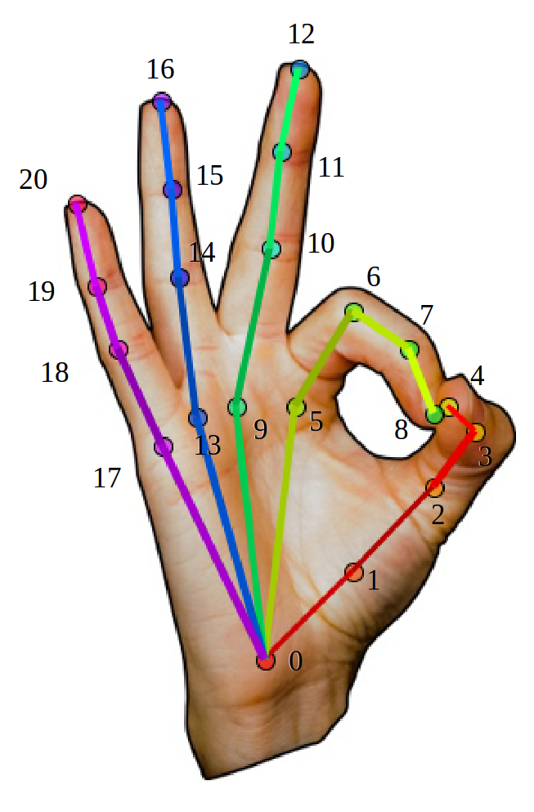
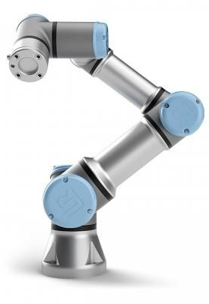
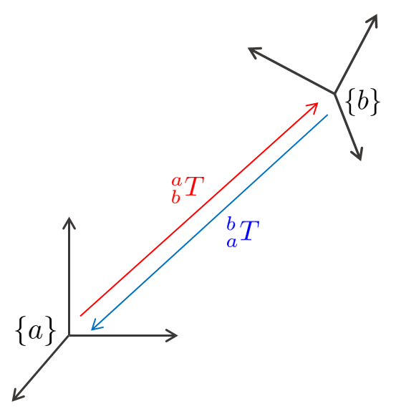
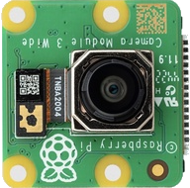
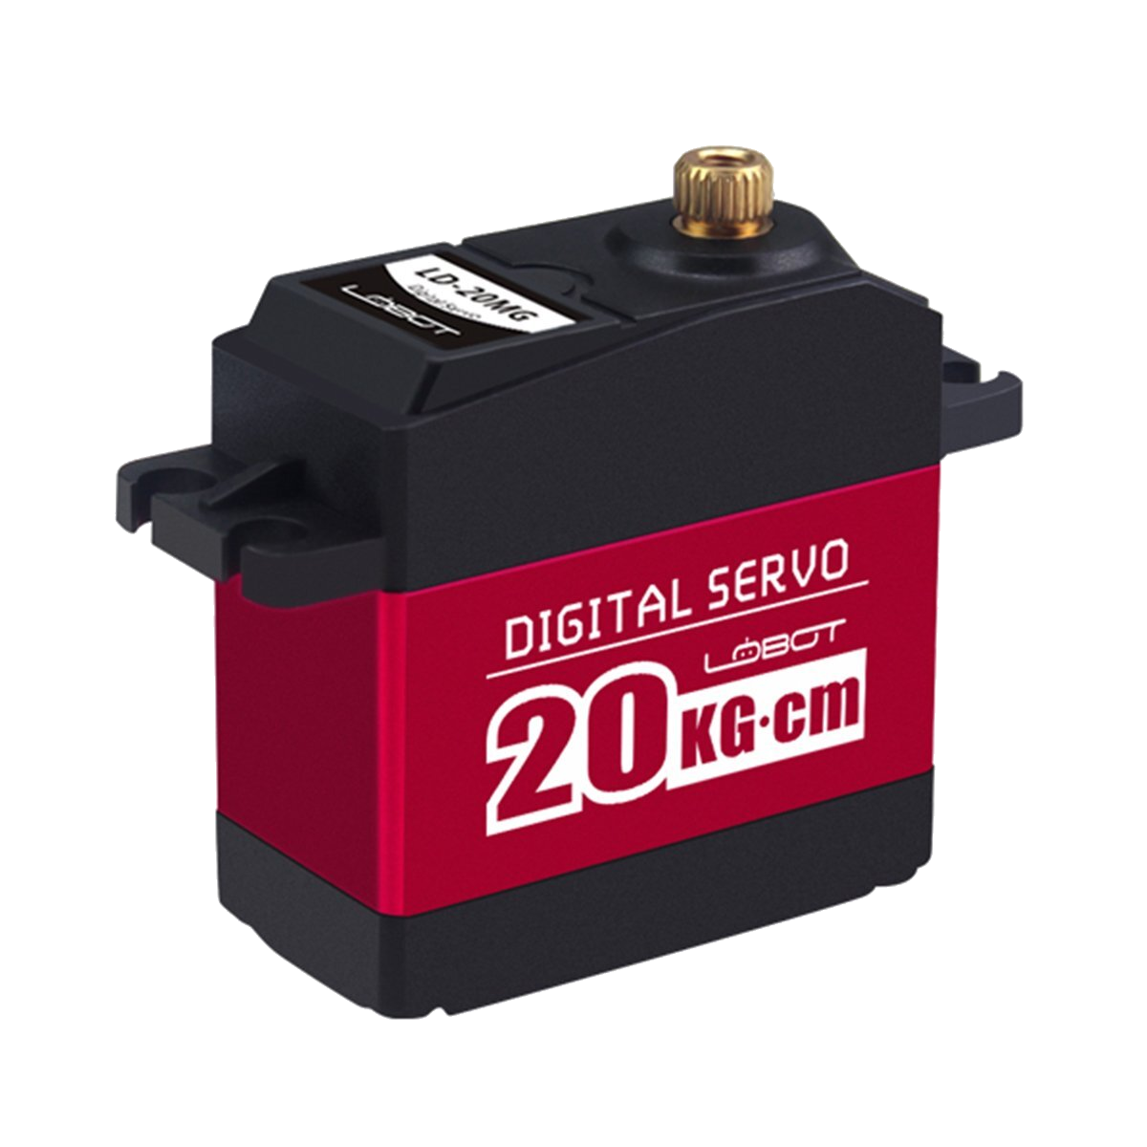
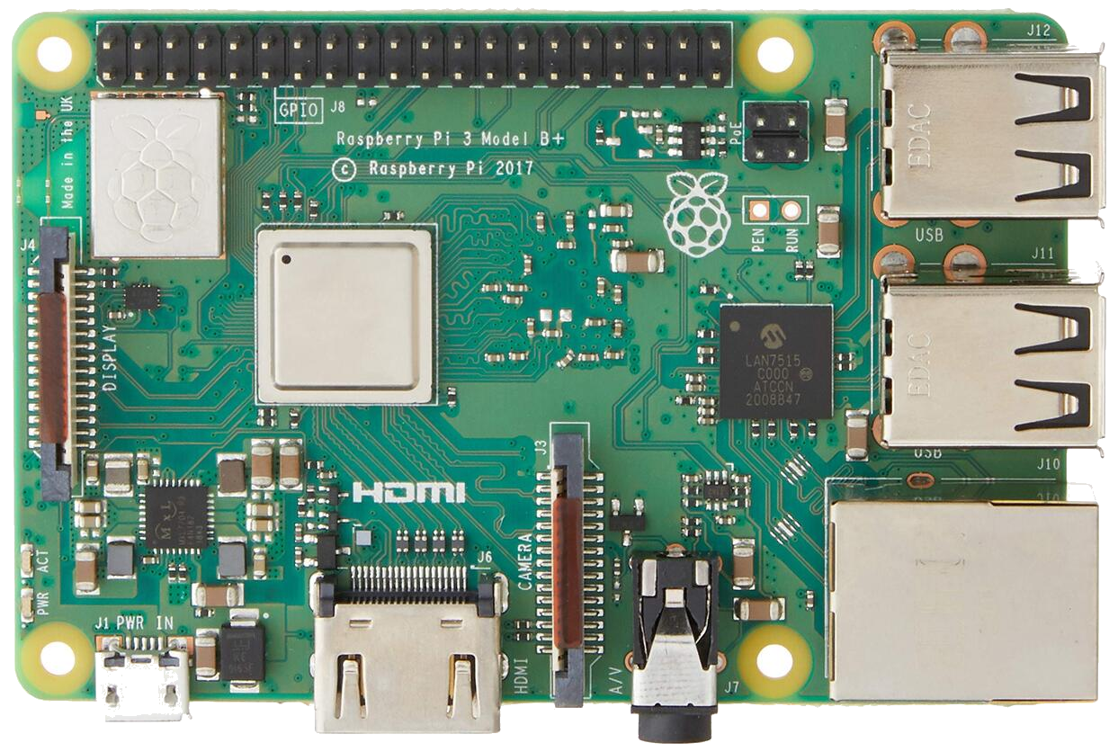
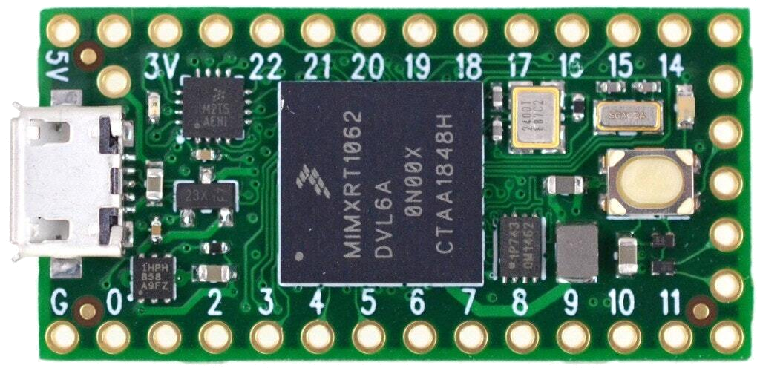
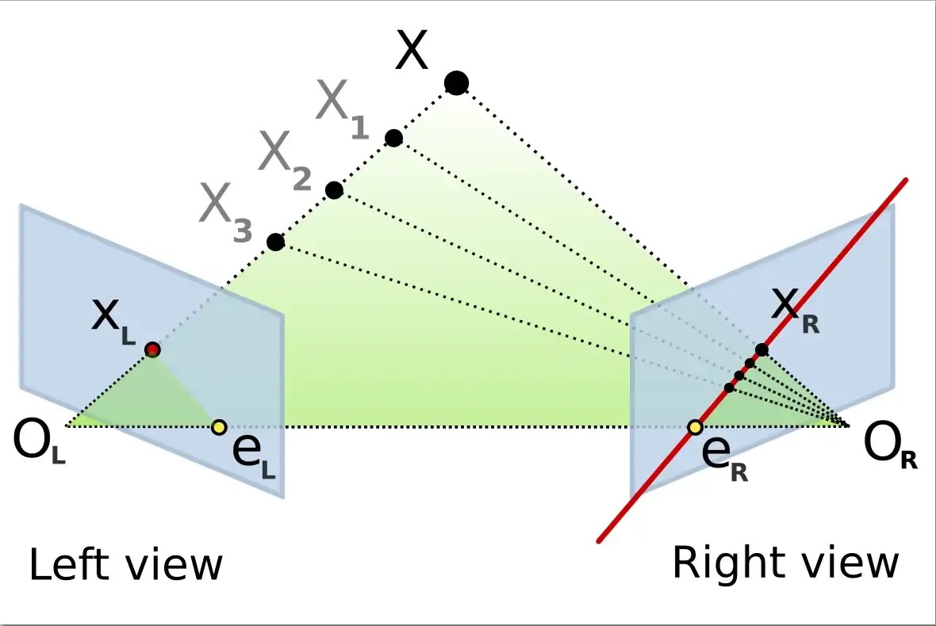
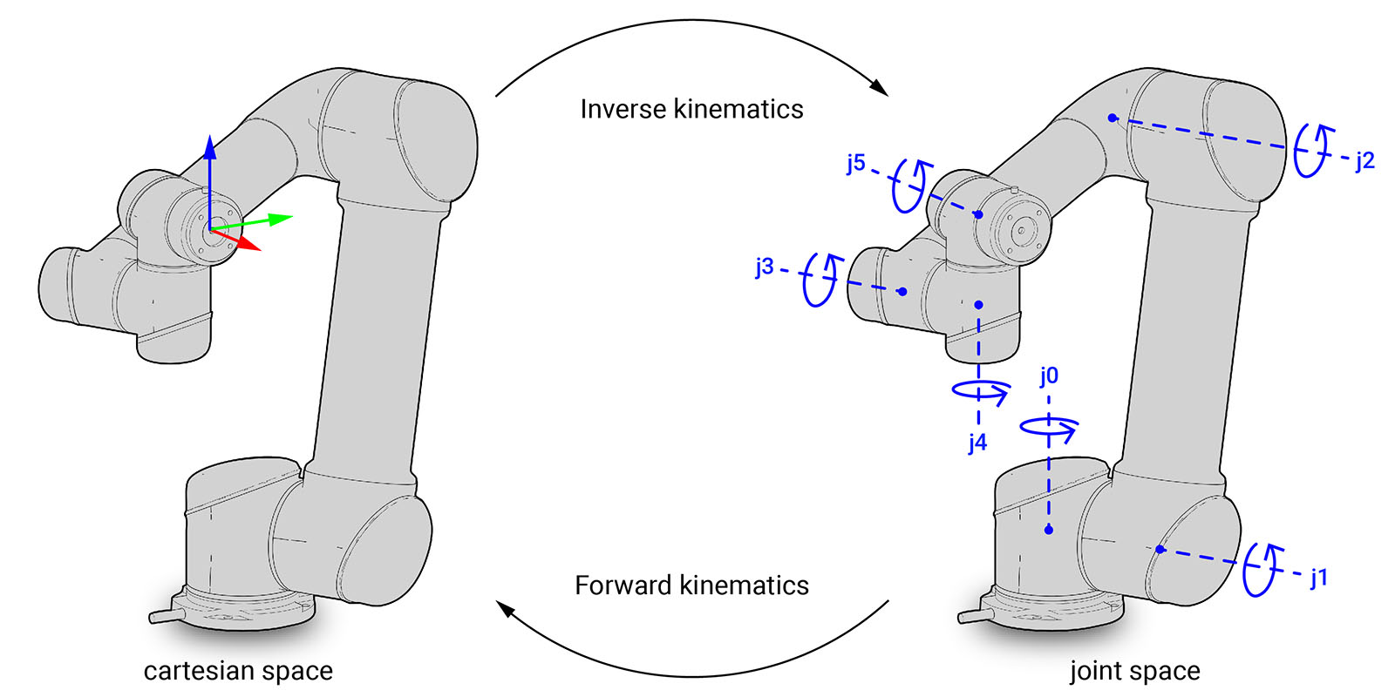
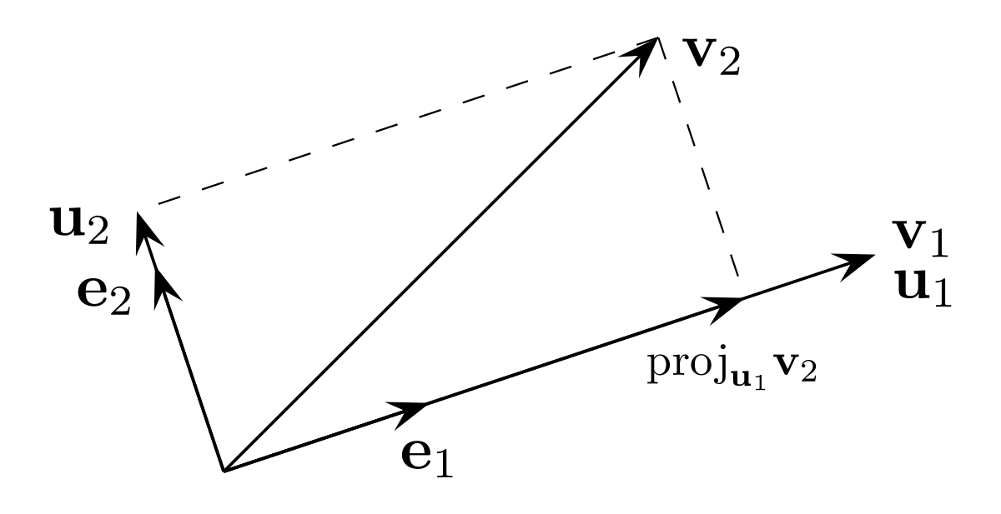
Intuitive Control of a 6DoF Robot Arm
EECS 452: Digital Signal Processing Design Lab (Winter 2023)
Nick Farid, John Getty, James Wishart, Justin Yu
Motivation
Control Flow
Progress
Improve human-robot interaction (HRI)
Enhance control of high degree-of-freedom (DoF) robotic arms; unintuitive with traditional input devices
Remove need for mechanically complex input hardware
During the internal pitch of this project idea, the hand tracking pipeline was demonstrated using a laptop webcam, with the ability to extract hand skeleton segment pixel coordinate information.
Currently, no progress has been made on the hardware development of this project; course is still in instruction until roughly halfway through the semester.
This poster therefore represents our project concept thus far and lays out the anticipated hardware implementation.
Localization
Inverse Kinematics
Introduction
CV/ML Hand Skeleton Segmentation and Tracking
3D Pose Mapping from World Frame to Robot Frame
Real-Time Actuator Angle Control
We aim to create an intuitive real-time
tele-operation control scheme for robotic arms (RAs) that emulates the movement of a human arm-hand end effector system.
Stereo Computer Vision (CV) with an integrated Machine Learning (ML) pipeline will be used to implement hand pose estimation and localization in 3D space.
The localized hand pose is re-mapped to the coordinate frame for a 6 DoF RA. The joint angles are calculated and the RA is actuated to achieve the desired pose.
System Architecture
Stereo Cameras
Next Steps
Raspberry Pi 4
Teensy 4.0
RA Joint Actuators (x6)
Research and gather pertinent literature for the discussed algorithms and techniques
Purchase hardware necessary for vision pipeline development
Define stereo camera physical configuration
Develop or purchase RA Hardware
Develop hardware suite for testing the RA
Algorithms / Techniques
Challenges
Real-world coordinate frame must be re-mapped to RA coordinate frame
Appropriate re-map scaling is required
Human arm/hand linkage system is not analogous to 6 DoF RA linkage system
Inverse Kinematics (IK) is required to solve for RA joint angles
RA self-collision must be reconciled
Re-mapped hand pose may end up outside RA configuration space
Must construct orthogonal frame from 3D hand pose information
Data time-sync between stereo cameras
Epipolar Lines in Stereo CV
Forward/Inverse Kinematics
Acknowledgements
We thank Dr. Armin Sarabi and Audrey Cooke for their help and guidance on this project. We would also like to thank Dr. Sarabi for providing the funding that allowed this project to happen.
Gram-Schmidt Orthogonalization Algorithm

